Slide 1
Eyes and Mind: The Basics of Photographic Composition
Al Francis D. Librero
Assistant Professor
Faculty of Information and Communication Studies (FICS)

Slide 2
Photography Series
Part 1: Eyes and Mind (Composition)
Part 2: Technique (Exposure)
Part 3: Post Production

Slide 3
Elements of Design
Line
Shape
Form
Texture
Pattern
Color

Slide 4
Elements: Line
A straight or curved continuous extent of length without breadth.
Most basic, but perhaps most powerful element
Evoke various senses and feelings
Directs your eyes to move at a specific direction across an image.

Slide 5
Elements: Shape
An outline of an object
An arrangement of lines
Principal element of visually identifying a subject

Slide 6
Elements: Form
Provides depth and perspective on a shape
Shape = 2D ; Form = 3D

Slide 7

Elements: Texture
Tactile quality of a surface
Associated with our sense of feel
Capable of evoking strong feelings

Slide 8
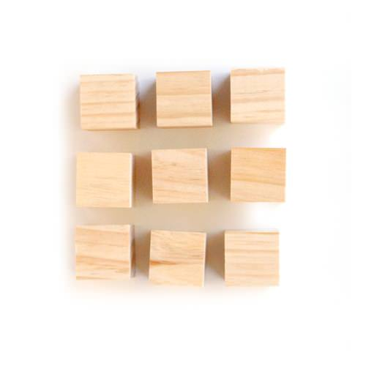
Elements: Pattern
Evokes a feeling of stability and predictability
An arrangement of shapes or forms that can be considered as organized or consistent

Slide 9
Elements: Color
Quality of an object or substance with respect to light reflected by the object
First thing a viewer notices in an image
Elicit or suggest what may as well be the widest variety of feelings among all other elements

Slide 10
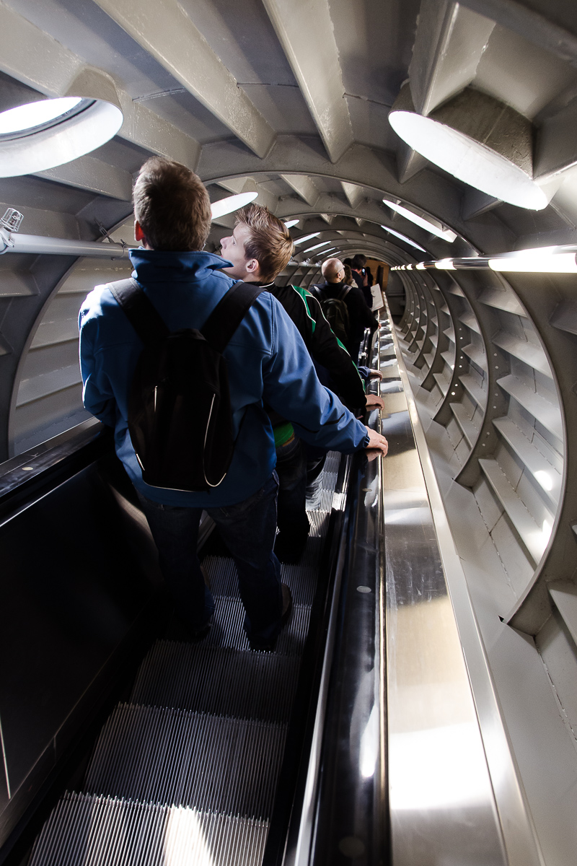
Elements of Design

Slide 11

Elements of Design

Slide 12
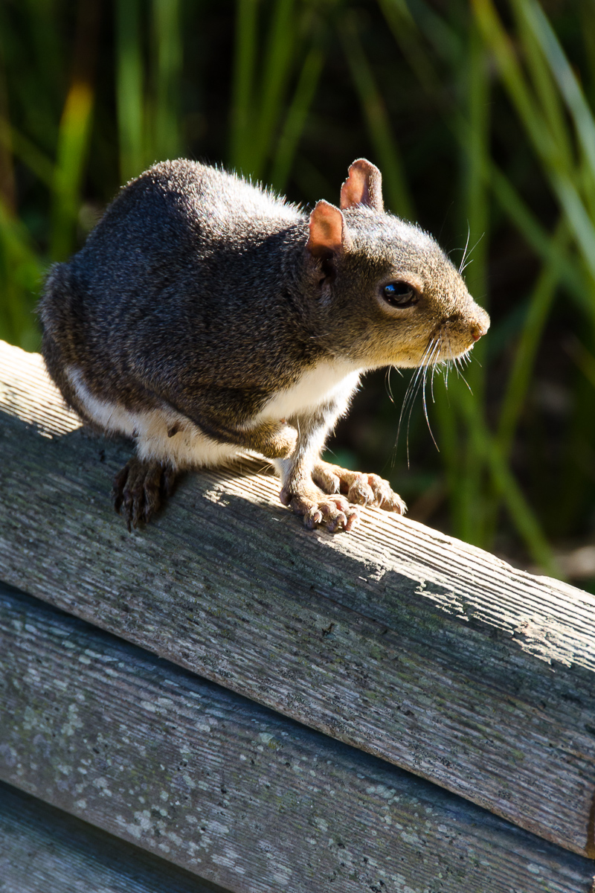
Elements of Design

Slide 13
Elements of Design

Slide 14
Principles of Design
Harmony
Balance
Contrast
Emphasis
Unity

Slide 15
Principles: Harmony
Relationship between different elements
The quality of forming a pleasing and consistent whole.

Slide 16
Principles: Balance
A situation in which different elements are equal or in the correct proportions.

Slide 17
Principles: Contrast
Differences in colour, tone, or shape that contribute to the visual effect of a design or image.
Provides drama or even conflict in a frame.

Slide 18
Principles: Emphasis
Special importance, value, or prominence given to something
Assignment of an object as a central point of interest

Slide 19
Principles: Unity
The quality or state of being one.
Combining of parts into a complex, but harmonious whole.

Slide 20
Photographic Composition
Alphabet = design elements
Grammar and syntax = design principles
Message or story = composition

Slide 21
Photographic Composition
Composition
Principles
Elements

Slide 22
Photographic Composition
The way in which a whole or mixture is made up.
Not as a strict set of rules, but a guide for identifying a scene’s general structure

Slide 23

Composition: Rule of Thirds
Placement of a subject along the lines of an equally divided 3x3 grid over a frame.

Slide 24
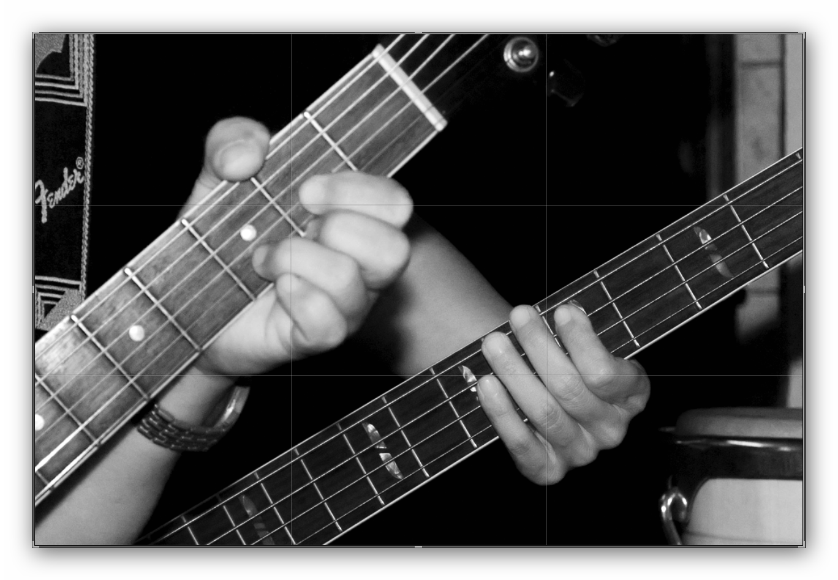
Composition: Rule of Thirds

Slide 25
Composition: Rule of Thirds

Slide 26

Composition: Rule of Thirds

Slide 27
Composition: Rule of Thirds

Slide 28
Composition: Radial
Radial composition is achieved when you have elements spread out from the center of a frame.

Slide 29

Composition: Radial

Slide 30
Composition: Leading Lines
Placement of subjects along a line, which can either be explicit or implicit.
Effective tool in dictating how viewers move their eyes across a picture

Slide 31

Composition: Leading Lines

Slide 32
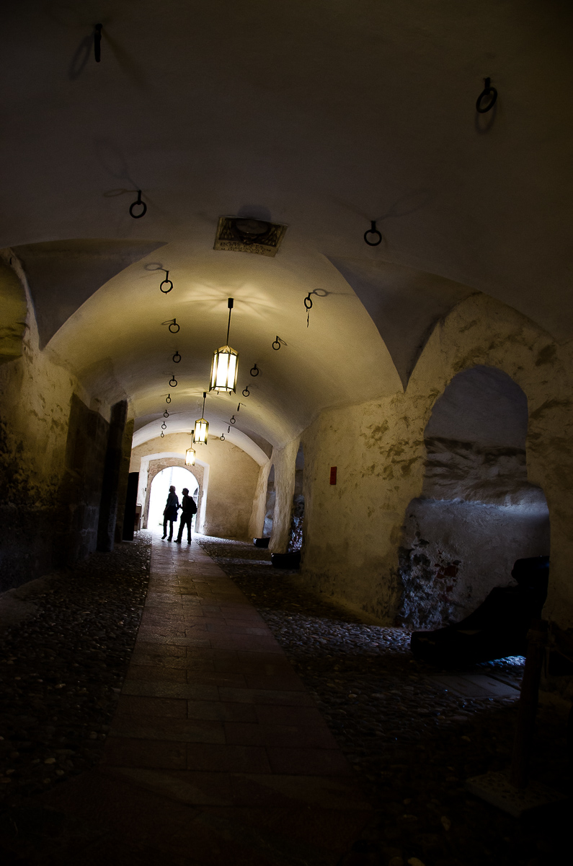
Composition: Leading Lines

Slide 33
Composition: Overlapping
Have subjects partially cover each other.
Can be achieved by:
having at least two elements of different distances from the photographer’s perspective and having one being in front of the other
having multiple elements of different lateral positions looking like they are in contact, implying a degree of togetherness.

Slide 34

Composition: Overlapping

Slide 35
Composition: Tall Crop
Further narrowing of a frame with vertical orientation
Removes unwanted elements on the left and/or right side of the frame
Provides greater emphasis on the subject.

Slide 36

Composition: Tall Crop

Slide 37

Composition: Tall Crop

Slide 38
Composition: Letterbox
Further narrowing of a frame with horizontal orientation
Removes unwanted elements on the upper and/or lower side of the frame
Provides greater emphasis on the subject.

Slide 39

Composition: Letterbox

Slide 40

Composition: Letterbox

Slide 41
Composition: Symmetry
The quality of being made up of exactly similar parts facing each other or around an axis

Slide 42
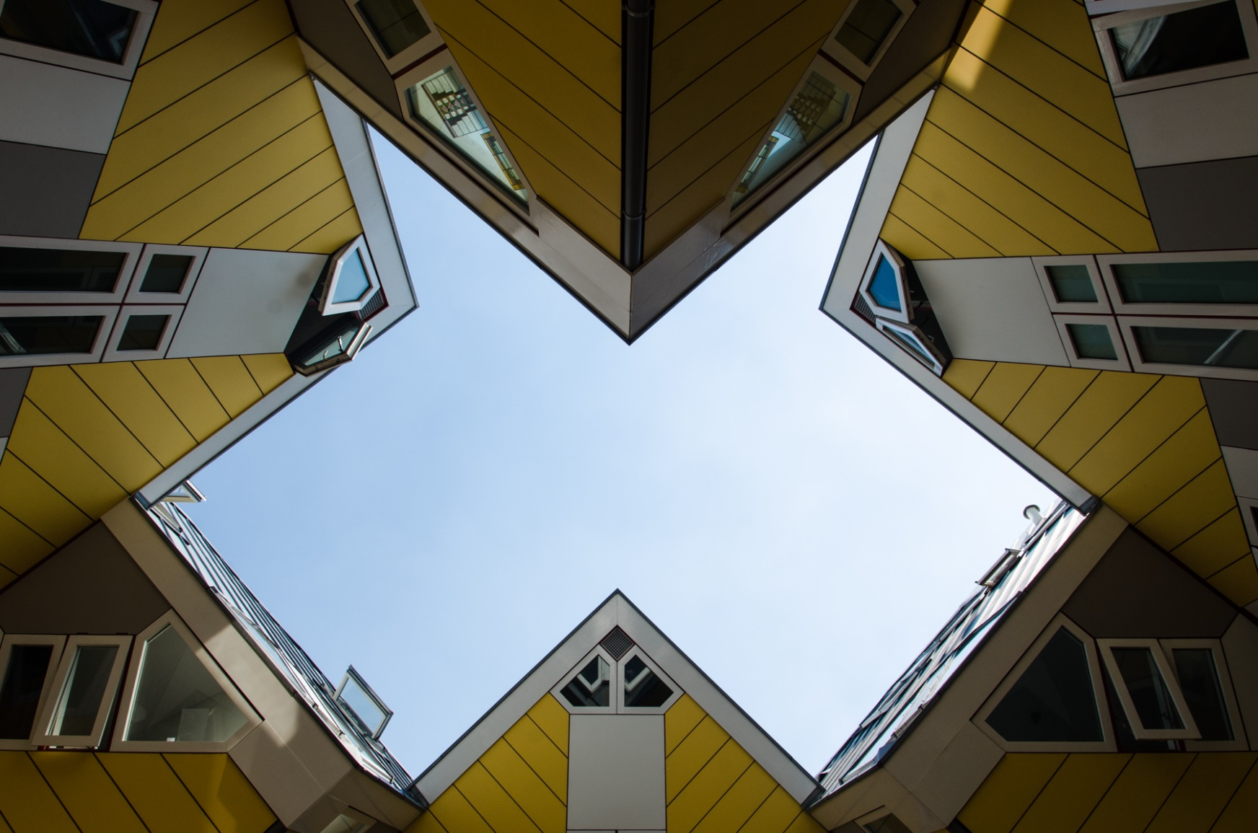
Composition: Symmetry

Slide 43
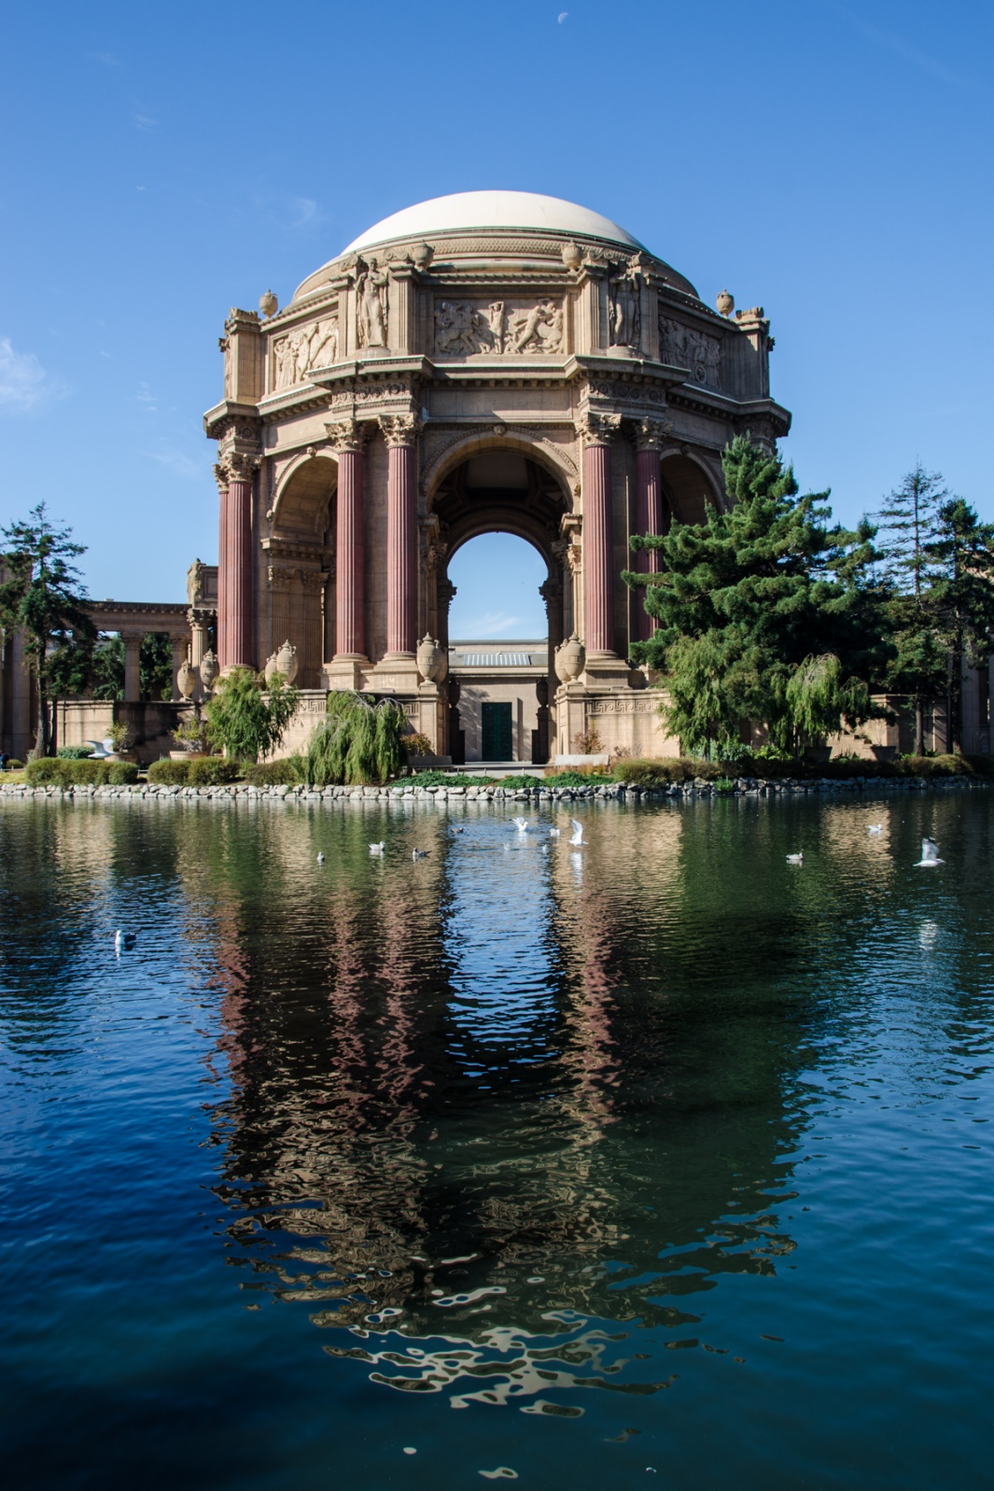
Composition: Symmetry

Slide 44
Composition: Frame Within a Frame
Use of an element or elements in the foreground or background as additional frames for a subject.
Adds depth, perspective and emphasis on a subject.

Slide 45

Composition: Frame Within a Frame

Slide 46
Composition: Rhythmic Elements
Deliberate and purposeful repetitions of any design element

Slide 47

Composition: Rhythm

Slide 48
Composition

Slide 49
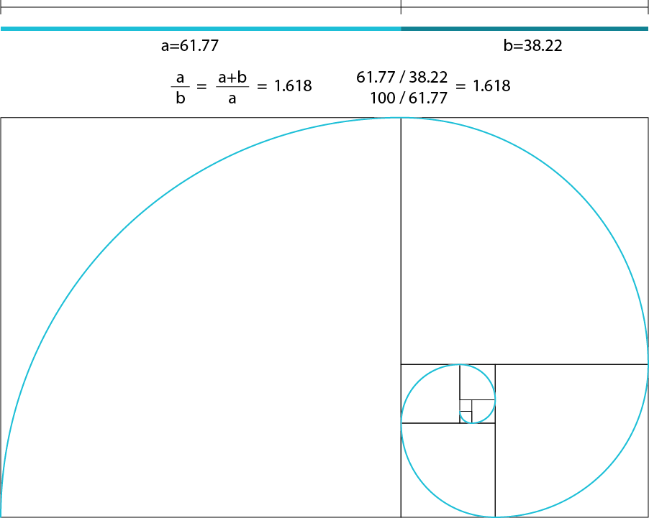

Composition: Golden Ratio
Placement of subject and elements of interest along the lines of a Phi grid or the Fibonacci Spiral, as with the rule of thirds
1:0.618:1 grid ratio as opposed to the 1:1:1 ratio of the rule of thirds

Slide 50

Composition: Golden Ratio

Slide 51

Composition: Golden Ratio

Slide 52
Composition: Fill the Frame
Maximizing the space within the dimensions of a picture.

Slide 53

Composition: Fill the Frame

Slide 54

Composition: Fill the Frame

Slide 55
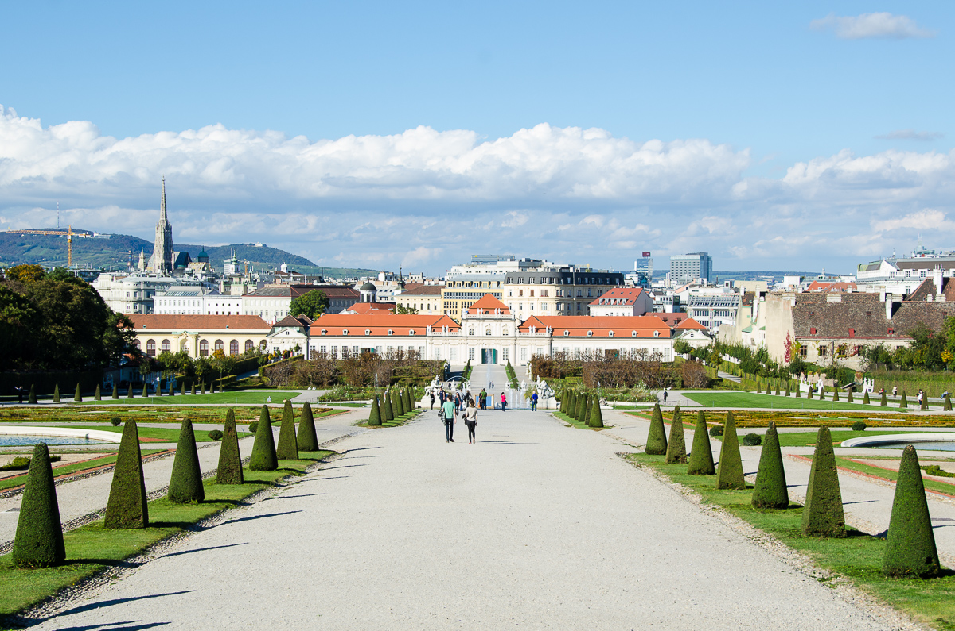
Composition:

Slide 56

Composition:

Slide 57

Composition:

Slide 58
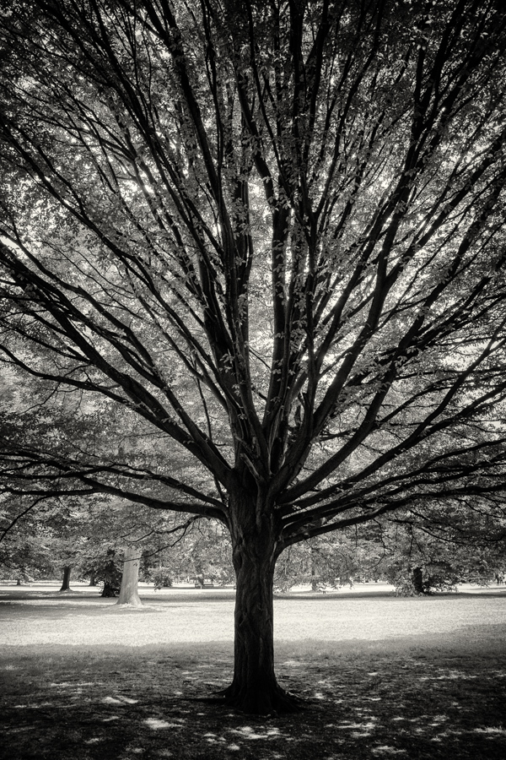
Composition:

Slide 59
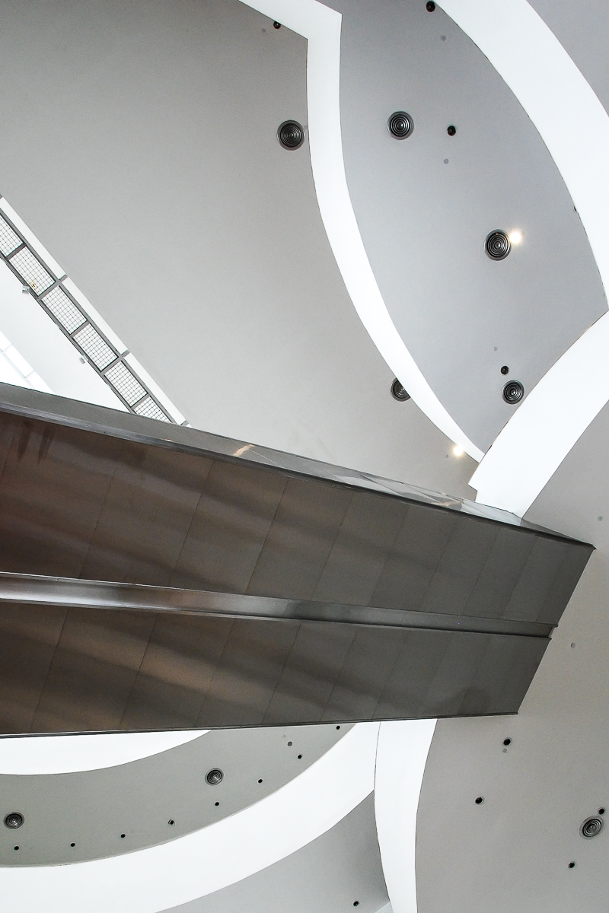
Composition:

Slide 60
Questions, Anyone?
Composition
Gear
Open Critique
Exposure “preview”

Slide 61
Thank you!
Multimedia Studies 173 Manual
http://www.allibrero.com/mms173

